Slide 1
Applied Studies - Design in Metal
Year 9 and/or 10

Slide 2
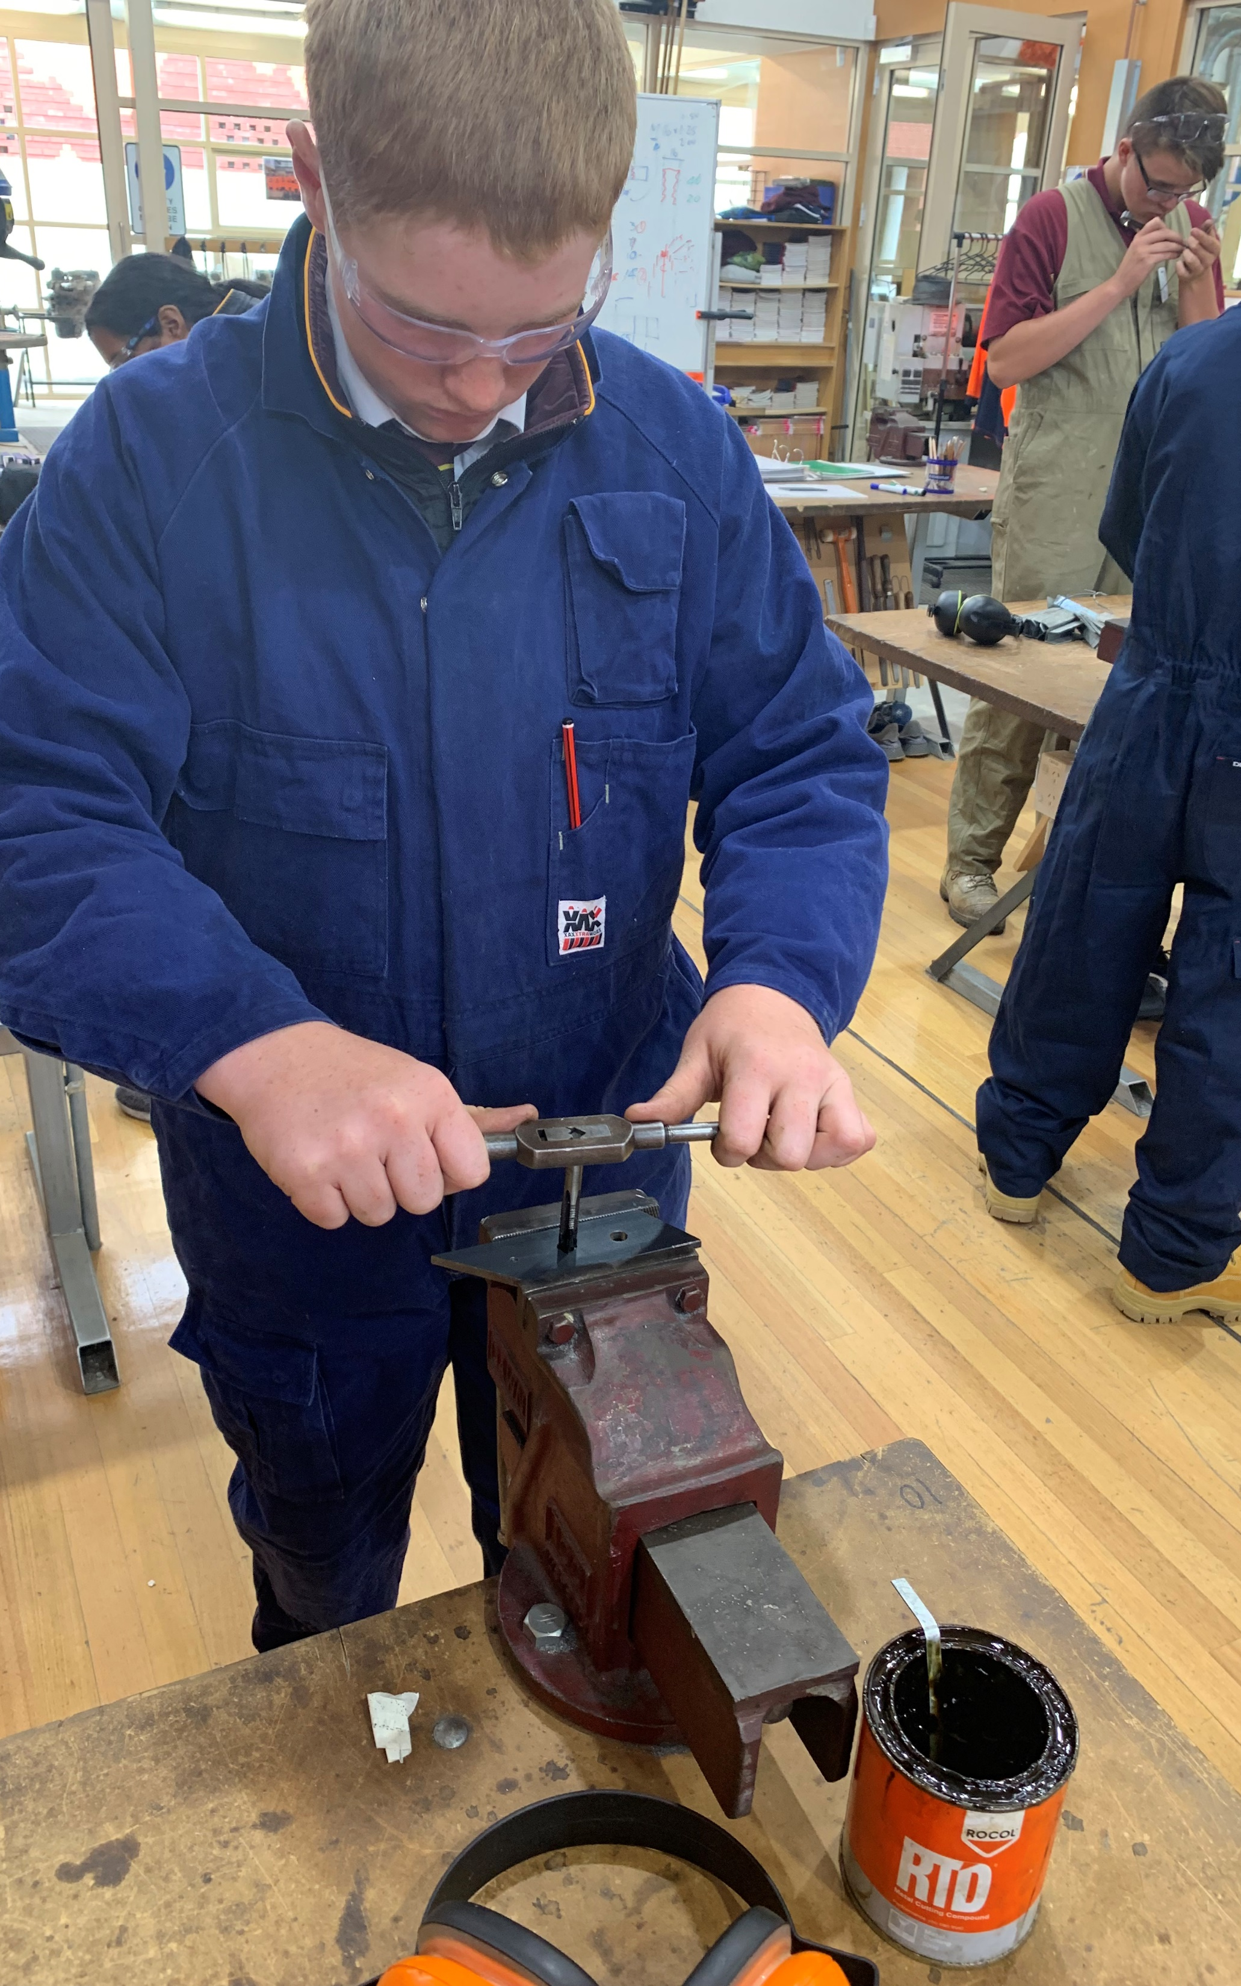
Design in Metal
1 or 2 year course
Prepares students for a Engineering/Metalwork pathway
Expands on skills learnt in Year 8 Design in Metal
Recommended this subject is taken in Year 9 if planning to enroll in the Intro to Engineering Pathways (VET) Course in Year 10
Focus on wearing Personal Protective Equipment (PPE) and Workshop Safety

Slide 3
Find out more…
Please feel free to contact Mrs Selina Kinne, Head of Technology and Applied Studies, at skinne@dominic.tas.edu.au

